Slide 1
Cyber Forensics Senior Project
Ryan Hinson

Slide 2
Statement of Purpose
The purpose of this project was to simulate a Cyber Forensics Investigation.
Cyber Forensics has become a big part of crime scene investigation and many people are still not sure what these analysts do.
I wanted to construct a project that gives a basic picture on the tools and the procedure of what Digital Forensics analysts do.

Slide 3

Research and Background
Common Artifacts looked for.
Industry standard tools
Kali Linux and Sift Workstation
FTK imager and Registry Viewer
ExifTool

Slide 4

Software and Hardware
Original Plan for two VMs
Sift workstation and ubuntu
Windows Machine with a second user
FTK Imager, Registry Viewer, ExifTool
Hard drive and flash drive
Write Blocker

Slide 5
Project Requirements
Create artifacts on the second user
Use FTK Imager to make images of the RAM and Hard Drive
Using tools, analyze the images for the created artifacts
Use timestamps learned to construct timeline of Criminals Activity

Slide 6
Demonstration

Slide 7
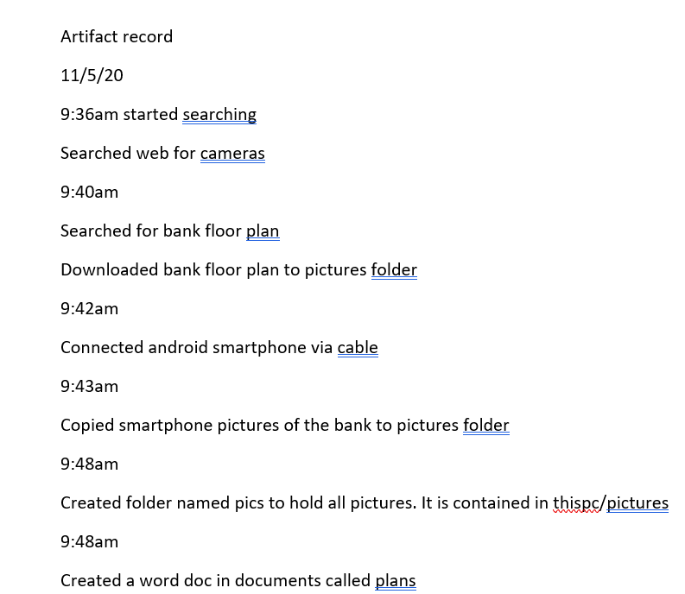
Creating Artifacts
Created a Second User on my PC
Did web searches, downloaded pictures from the internet
Connected a smartphone via USB
Transferred pictures from phone to computer
Connected to different Wi-Fi networks
Used these to do more searches and download more images
Created a word document and put it in the recycle bin

Slide 8
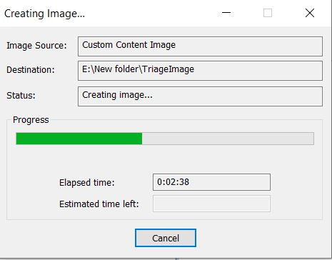
Imaging the Hard drive
Put FTK Imager on flash drive
Connected to the still running PC
Imaged Ram and Hard Drive
Created Custom Content images for a triage image

Slide 9
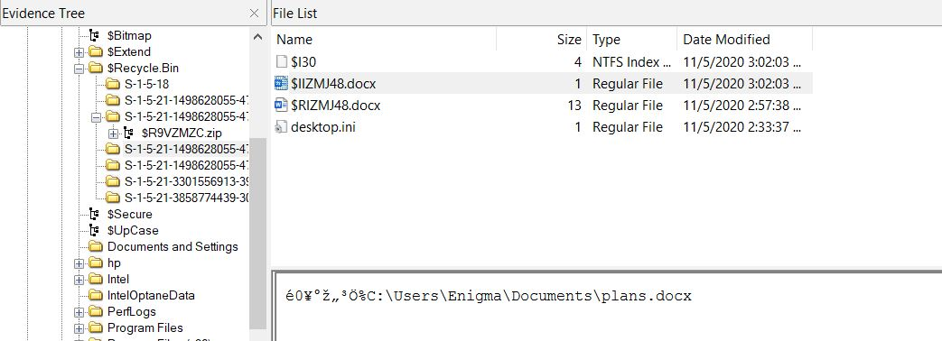
Using FTK Imager
Used to not only image the hard drive but to make triage images
Can also be used to find files in the image.
Gives some basic information on files
Industry Standard tool.

Slide 10
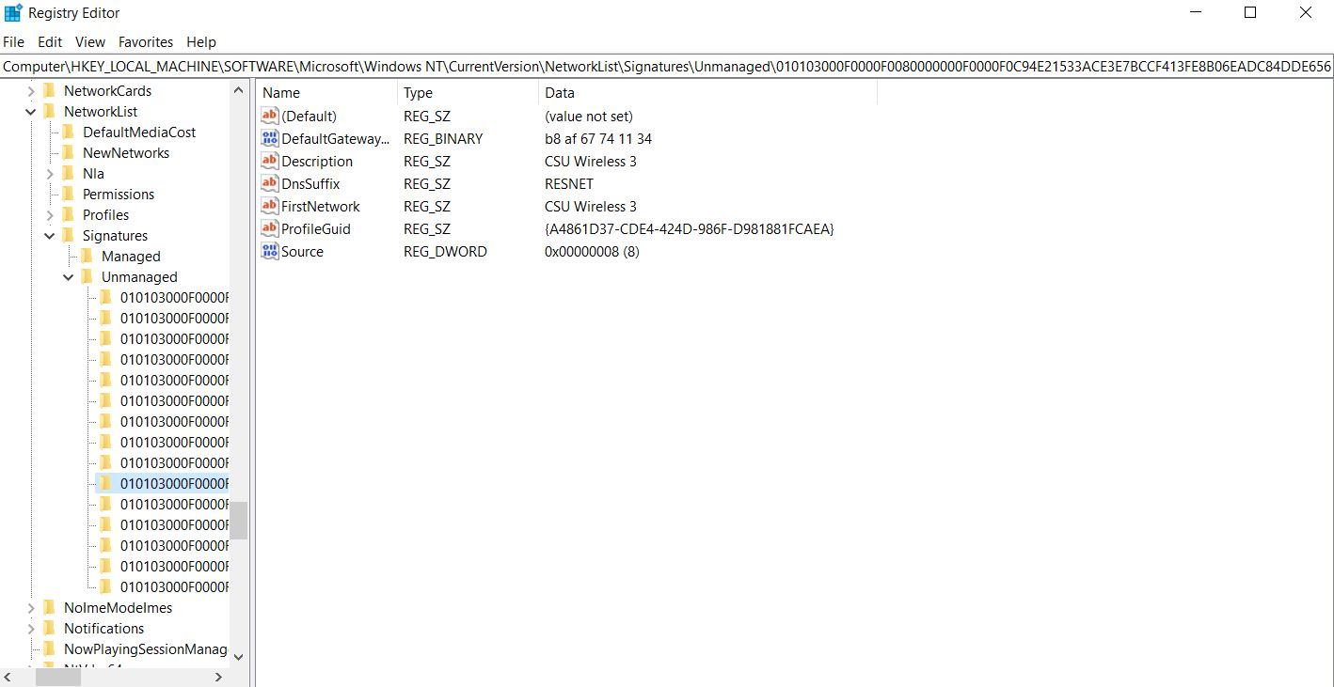
Using Registry Viewer
Used to view windows registry files
Allows for us to see system configuration
This includes profiles, Wi-Fi connections, and search history
Used in conjunction with FTK Imager

Slide 11
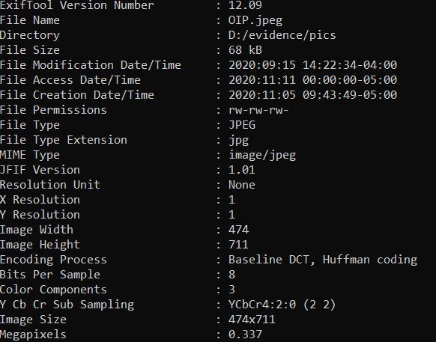
Using ExifTool
This tool allows for the viewing of metadata and lnk files
This can be used to see when files were created and last modified
Used to gain a timeline of when things were done by the criminal.

Slide 12
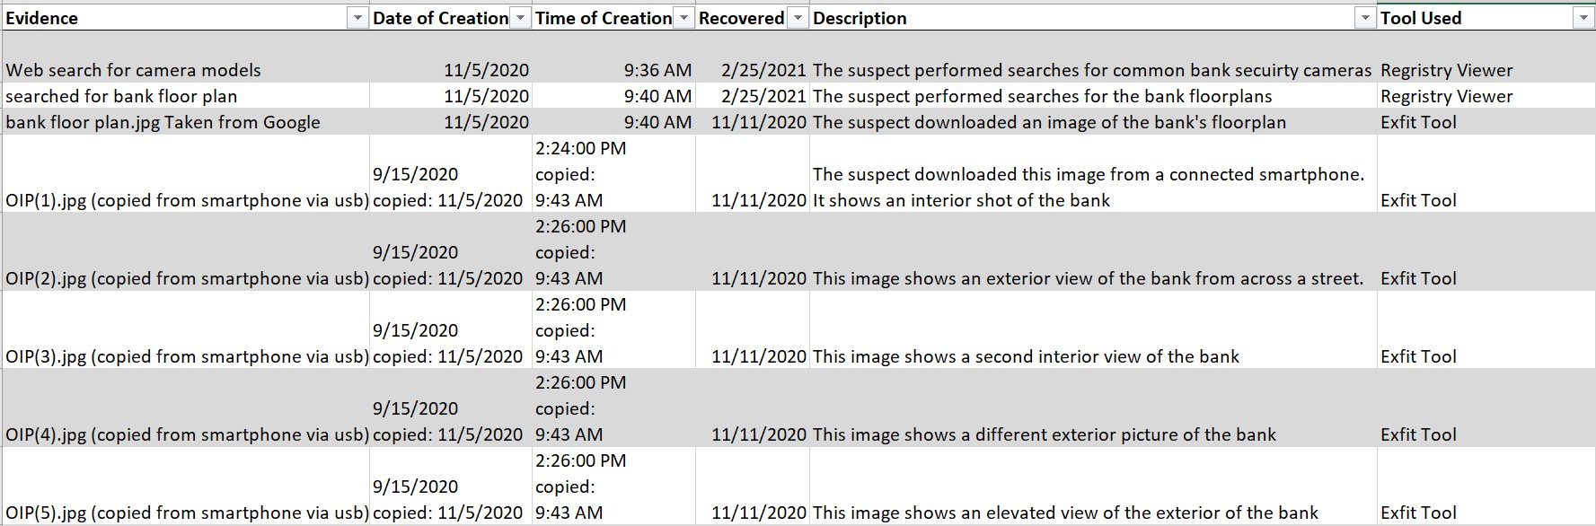
Forensic Log

Slide 13
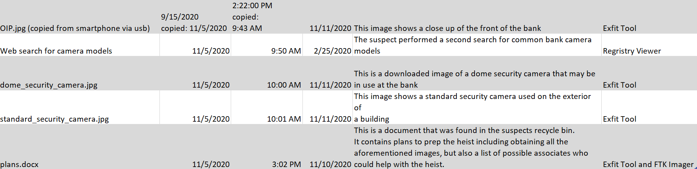

Slide 14
Challenges faces
Problems with VMs
Problem with first Image
Problem with Registry Viewer

Slide 15
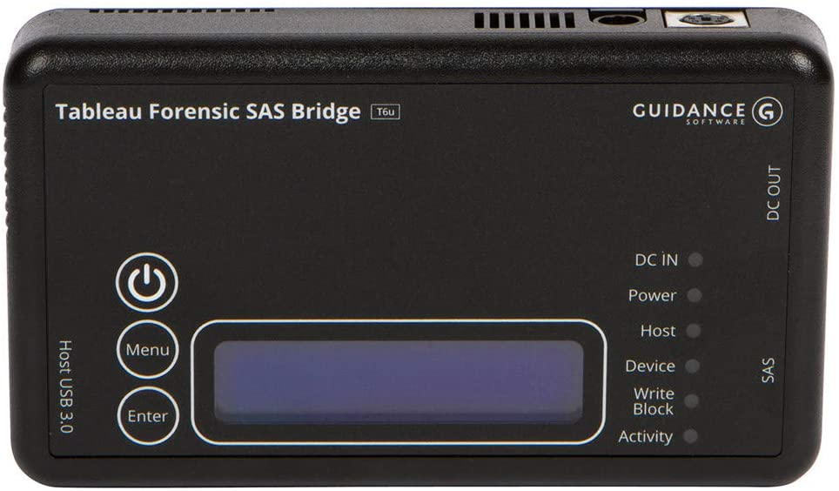
Future improvements
Using VMs
Having access to write blocker
Making more artifacts
Using more tools

Slide 16
Picture Sources
https://s.softdeluxe.com/icons/png/128/3555/3555359.png
https://storage.googleapis.com/webdesignledger.pub.network/WDL/6f050e39-windows_10_logoblue.svg-copy_windows.jpg
https://images-na.ssl-images-amazon.com/images/I/61C6xldizSL._AC_SL1280_.jpg

